Slide 1




NEXT GEN EMPLOYABILITY PROGRAM
Creating a future-ready workforce
Team Members
College Name
Student Name : Minu Marshal
Student ID : au960221104073
Arunachala College of Engineering for Women

Slide 2

CAPSTONE PROJECT SHOWCASE
Project Title
Car Rentals Application with Django Framework
Abstract | Problem Statement | Project Overview | Proposed Solution | Technology Used | Modelling & Results | Conclusion

Slide 3
Abstract
The "Car Rentals Application with Django Framework" is a robust web-based platform designed to streamline the process of renting vehicles.
Developed using the Django framework, this application offers a user-friendly interface for both customers and administrators, facilitating efficient management of car rental services.
Users can easily browse through a wide range of available vehicles, make reservations, and manage bookings, while administrators have access to comprehensive tools for inventory management, user authentication, and reporting.
With its intuitive design and powerful features, this application represents a sophisticated solution for businesses in the car rental industry, enhancing customer satisfaction and operational efficiency.
Source :

Slide 4
Problem Statement
The current problem facing the car rental industry is the lack of a unified and efficient digital platform for managing vehicle rentals.
Traditional methods often involve cumbersome paperwork, inefficient communication channels, and limited accessibility for customers. Additionally, existing digital solutions may lack comprehensive features or user-friendly interfaces, leading to suboptimal user experiences and administrative inefficiencies.
In response to these challenges, the development of a robust Car Rentals Application utilizing the Django Framework aims to address these pain points by providing a seamless and intuitive platform for both customers and administrators, streamlining the rental process, enhancing user satisfaction, and improving operational efficiency for car rental businesses.
Source :

Slide 5
Project Overview
The Car Rentals Application with Django Framework is a comprehensive digital solution designed to modernize and streamline the vehicle rental process.
Leveraging the powerful capabilities of the Django framework, this project aims to create a user-friendly web application that caters to both customers and administrators in the car rental industry.
The application will offer a range of features including vehicle browsing, reservation management, user authentication, inventory tracking, and reporting functionalities.
Customers will have the ability to easily search for available vehicles, make reservations, and manage their bookings, while administrators will benefit from tools for inventory management, user authentication, and generating reports to facilitate business insights.
Source :

Slide 6
Proposed Solution
.
The proposed solution for the Car Rentals Application with Django Framework encompasses the development of a robust and feature-rich web application tailored to meet the specific needs of the car rental industry.
Utilizing the Django framework's flexibility and scalability, the application will be designed with a modular architecture to ensure easy customization and future expansion.
Key features will include a user-friendly interface for browsing and selecting available vehicles, a reservation system with real-time availability checks and booking management capabilities, secure user authentication and authorization mechanisms, comprehensive inventory management tools for administrators to track vehicles, rental schedules, and maintenance records, as well as reporting functionalities to generate insights into business performance and customer trends.
Source :

Slide 7
Source :

Slide 8
Source :

Slide 9


Technology Used
Front-end
Back-end
Source :

Slide 10
Modelling & Results
Source :

Slide 11
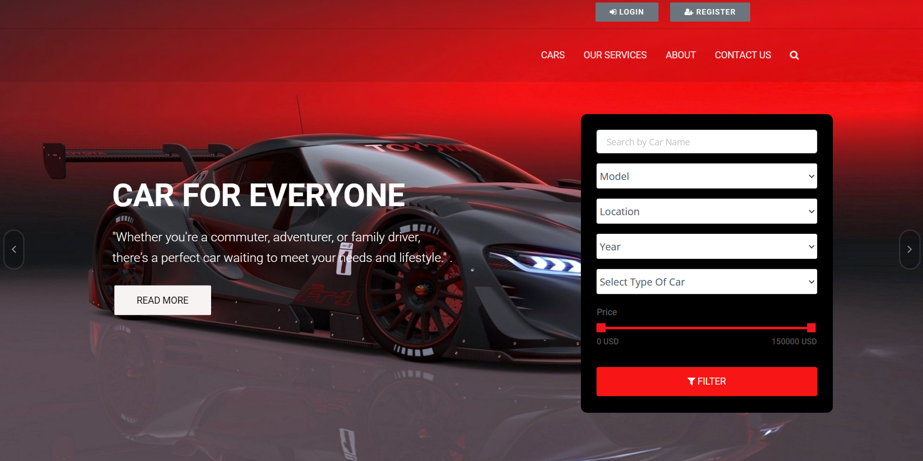
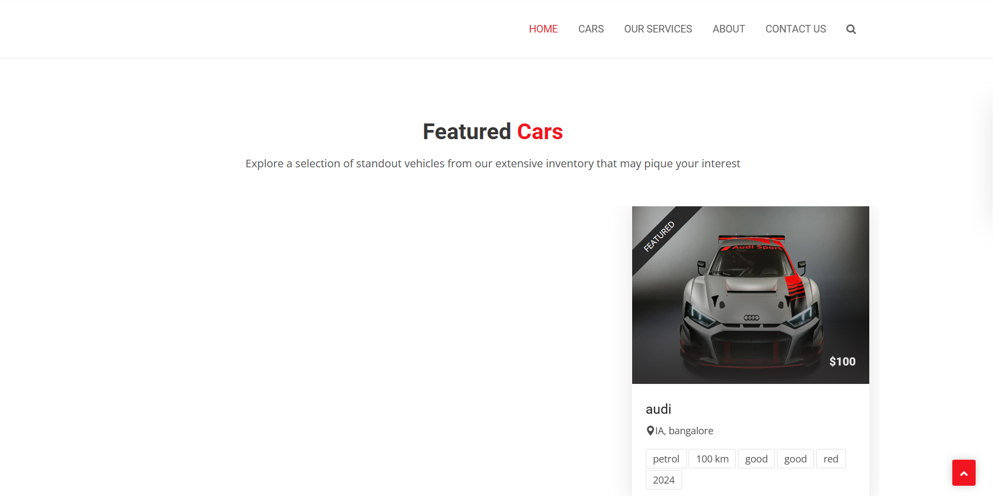
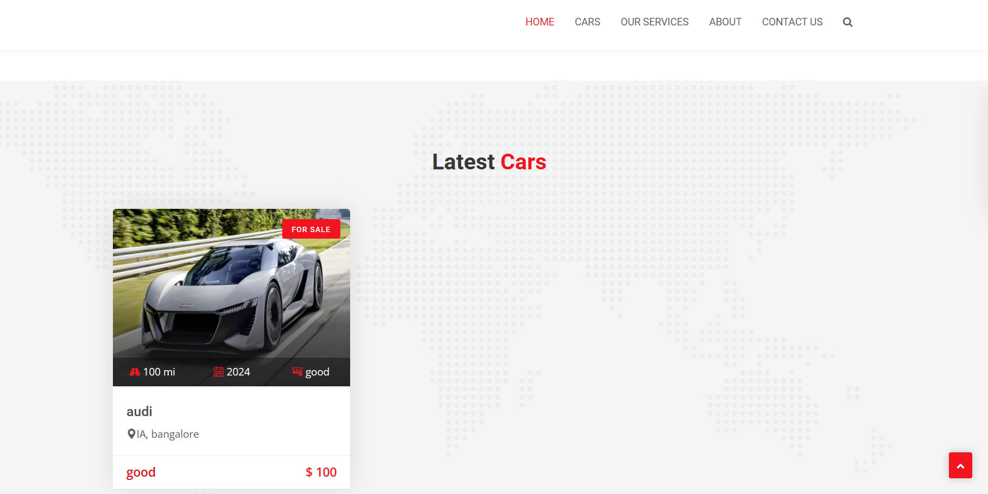
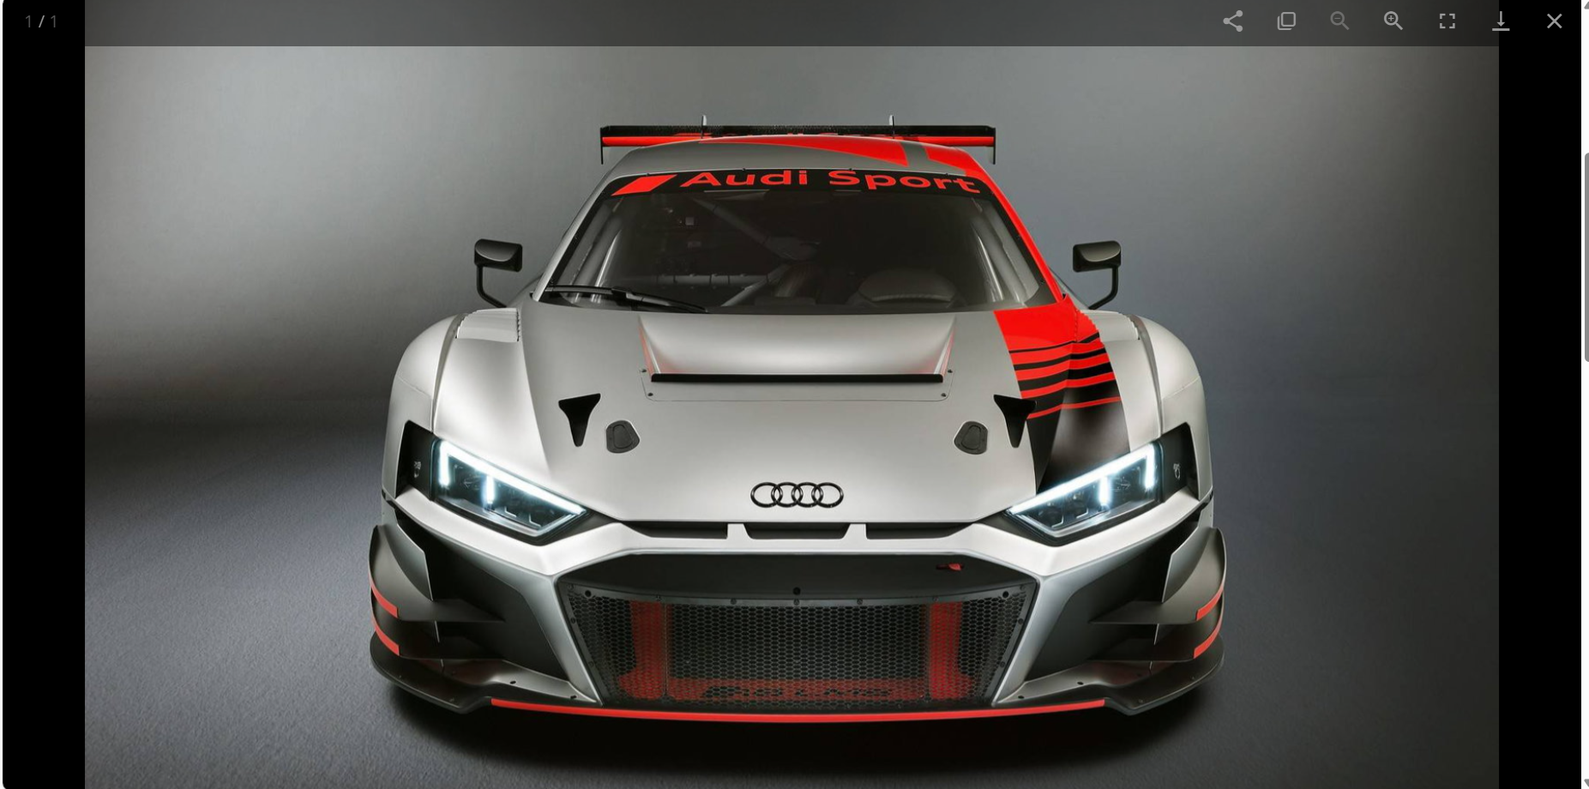
Homepage

Slide 12
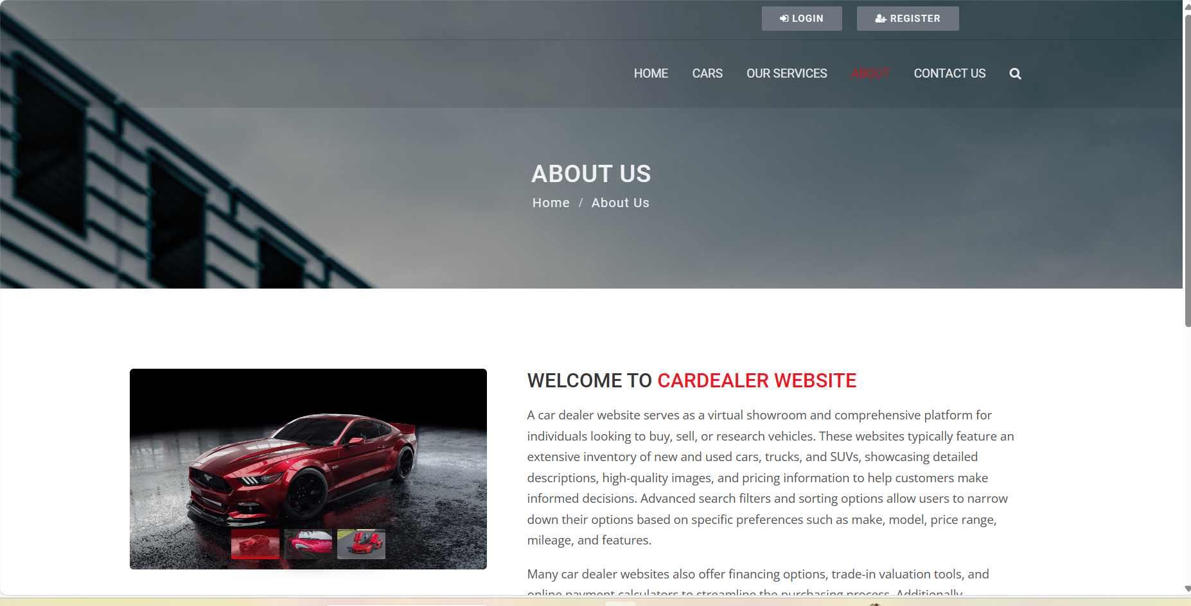
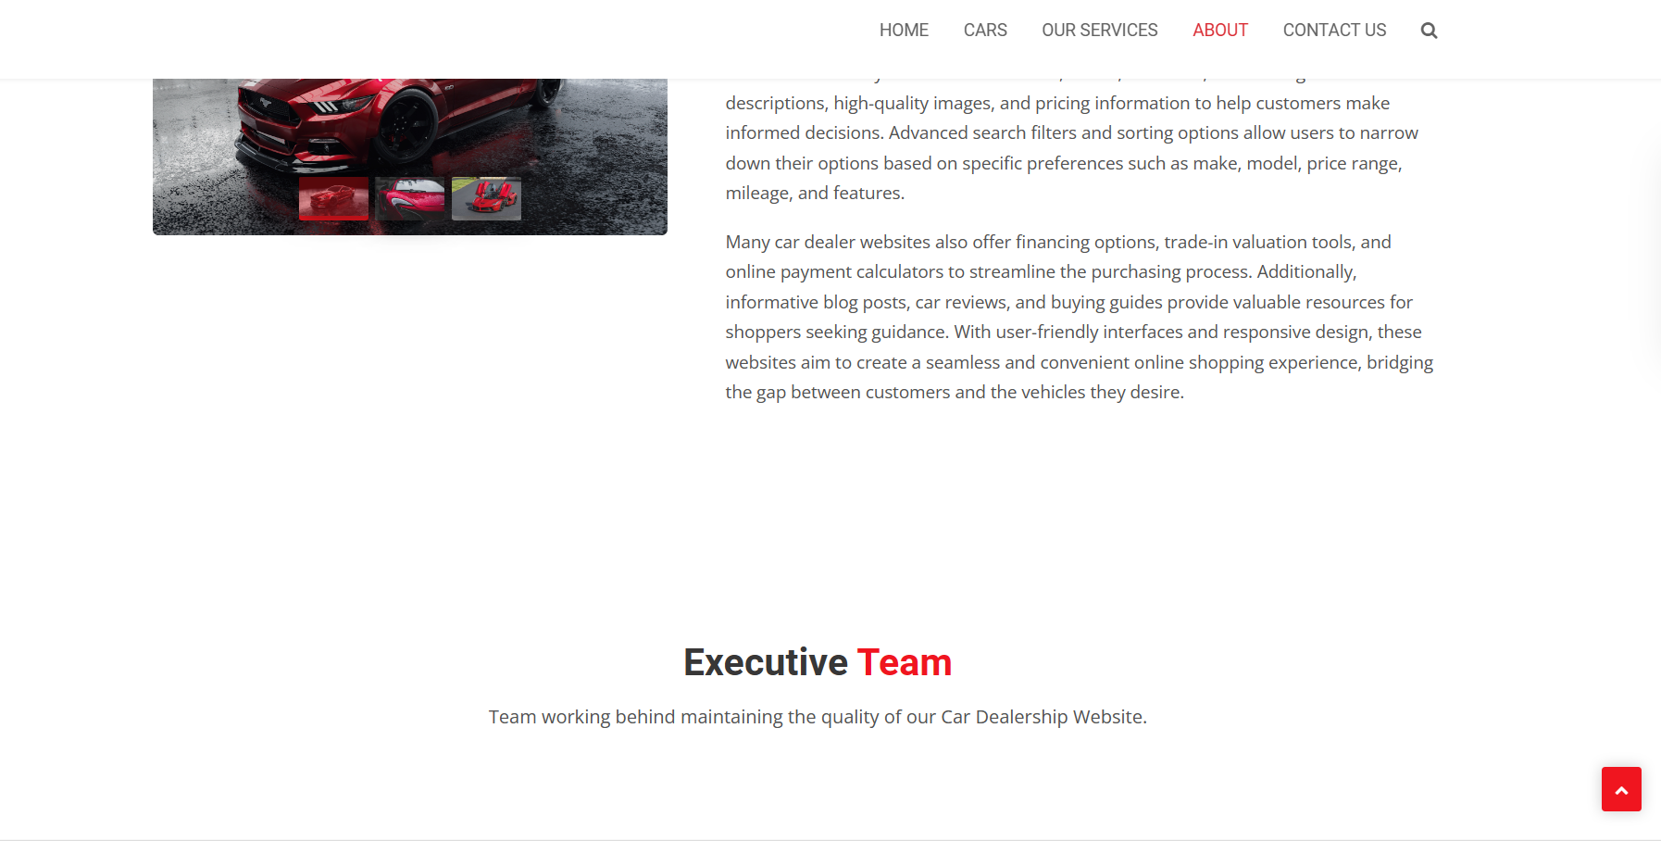
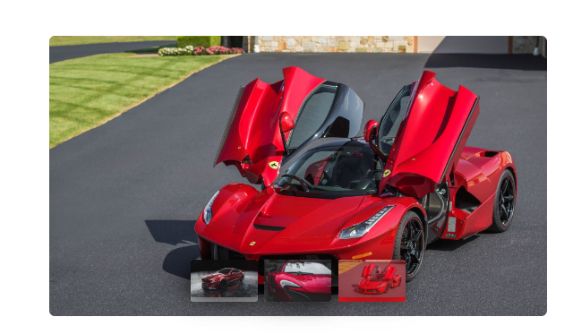
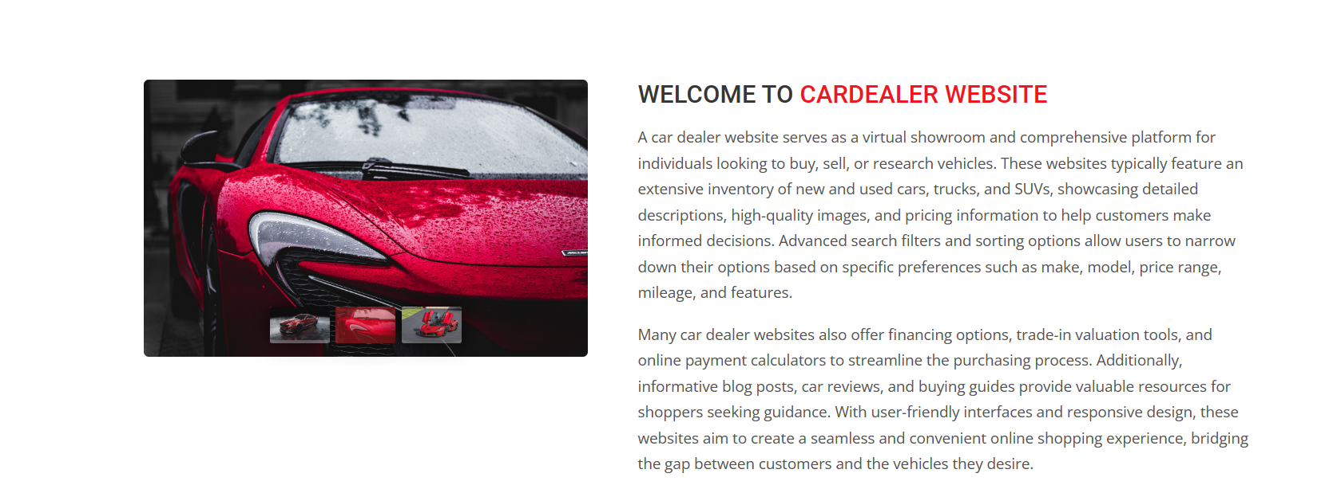
About-Us-Page

Slide 13
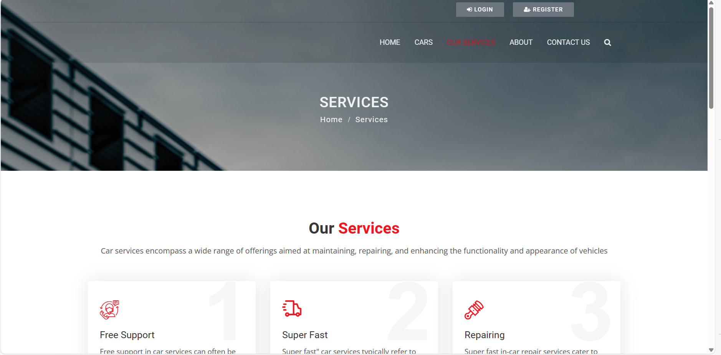
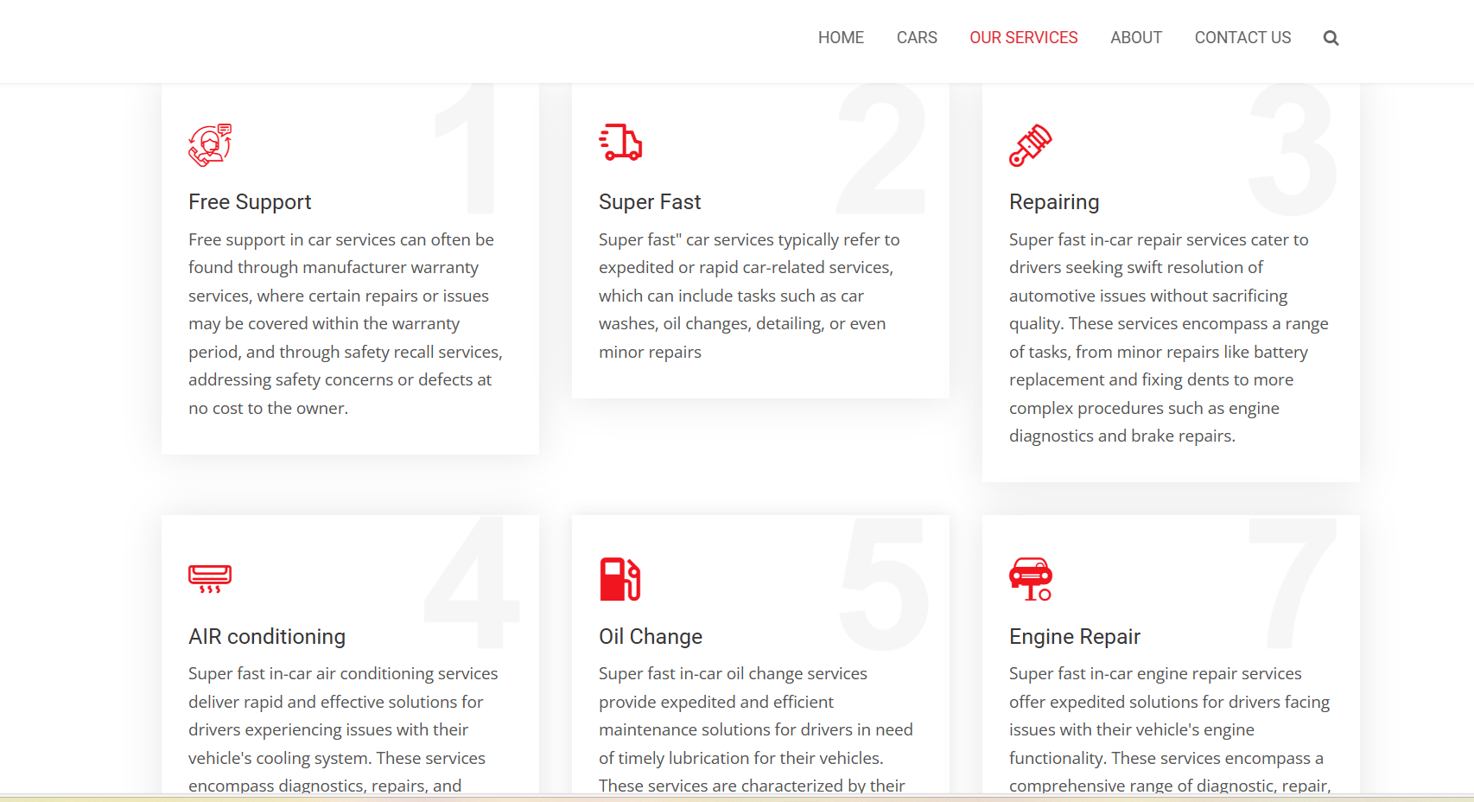
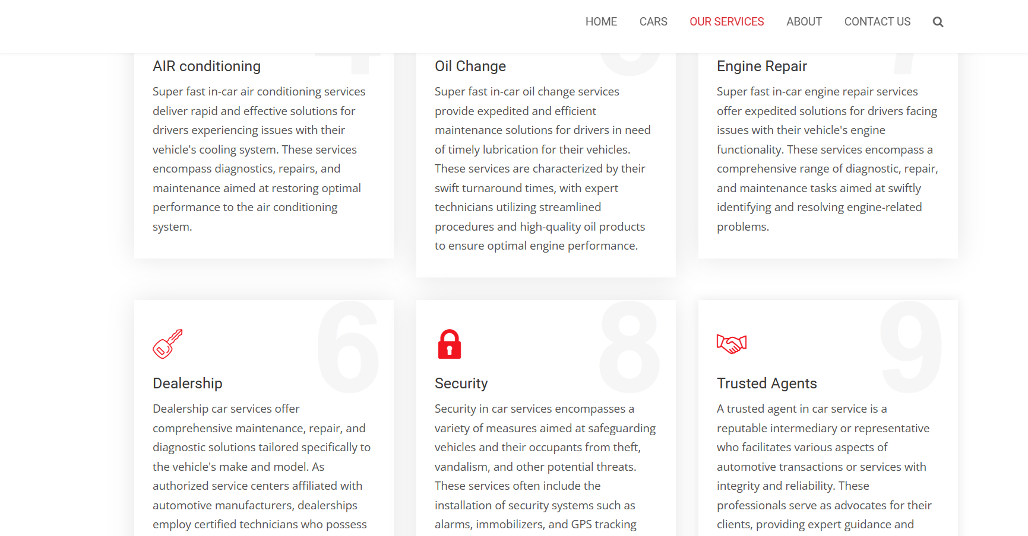
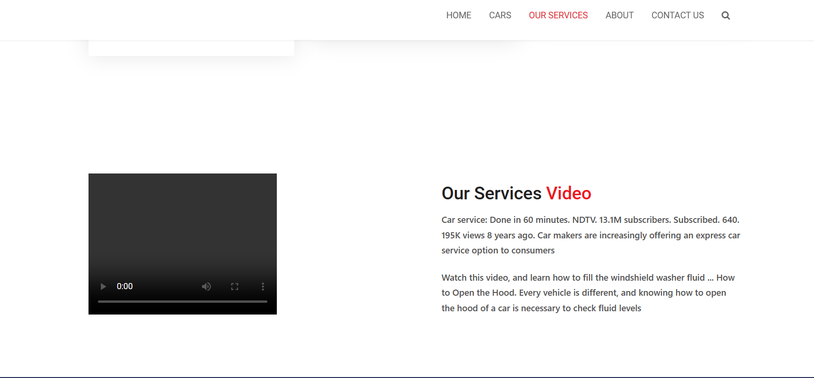
Service-Page

Slide 14
Cars-Page

Slide 15
Blog-Page

Slide 16
Future Enhancements:

Slide 17
Conclusion
Source :

Slide 18
Thank You!
Notes:
Thank You !!

